Slide 1
(CDR-2417) Optimizing The Resolution of Disputes
Lynn B. Larsen, CFCC
Lynn@LarsenAnalytics.com
801-541-9155

Slide 3
Please use microphone for all questions and comments!

Slide 4
Dispute Resolution: The Default Option
Court Litigation:
Decision by Judge or lay jury
Requires an Attorney
Public
Right to Appeal to higher court
Typically takes years
Can become very costly

Slide 5
Actual Case (Typical)
Contract signed in December 2009: $500,000
Construction December 2009 to January 2011.
March 2011, Contractor filed suit
(alleging delays and extra work)
Owner counterclaimed for Defective Work.
April 2016 Trial before jury.
March 2017 Judgment against Contractor.

Slide 6
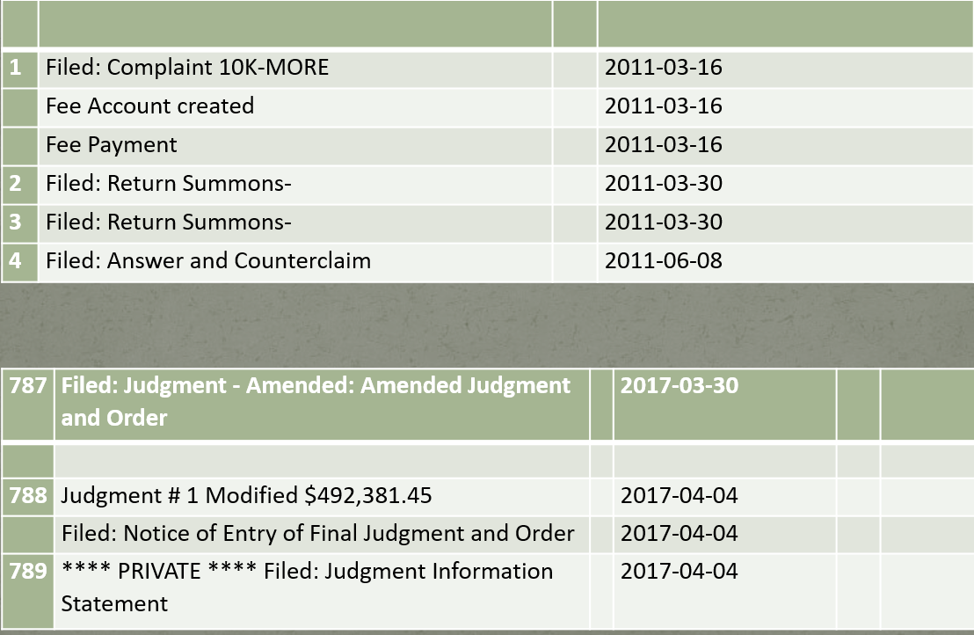
Case Docket:

Slide 7
Court Litigation vs ADR
The Cost and Delayed Resolution of Court Litigation led the Construction Industry to investigate Alternative Dispute Resolution (ADR) Methods

Slide 8
Alternative Dispute Resolution (ADR)
Negotiation
Mediation
Arbitration
Dispute Resolution Board (DRB)

Slide 9
Alternative Dispute Resolution (ADR) Methods
Negotiations
Early Resolution
In direct control
No attorney necessary
Timely
Little Cost
Does not work unless both parties want to resolve

Slide 10
Alternative Dispute Resolution (ADR) Methods
Mediation
Negotiation facilitated by neutral third party
Not Binding
Parties in control of dispute resolution
Gain understanding of other party’s position
If one party has no interest in resolving dispute, then mediation is a waste

Slide 11
Alternative Dispute Resolution (ADR) Methods
Mediation
Pure Mediation
Evaluative Mediation
Binding Mediation

Slide 12
Arbitration before 1 or 3 arbitrators
Private
Skilled Decision Maker
Generally Less Costly than Litigation
Resolution generally quicker than Litigation
Less Formal than Litigation
But can still become lengthy and expensive if Discovery is allowed.

Slide 13
Arbitration vs Litigation

Slide 14
Arbitration vs Litigation

Slide 15
Arbitration vs Litigation

Slide 16
Alternative Dispute Resolution (ADR) Methods
Arbitration Providers:
1. American Arbitration Association (AAA)
www.adr.org
2. Construction Dispute Resolution Services (CDRS)
www.constructiondisputes-cdrs.com
3. JAMS
www.jamsadr.com
4. Other Private organizations

Slide 17
DRB = Dispute Resolution Board
At time of contracting, parties jointly select 3 individuals to be “jobsite judges.”
Unbiased, Knowledgeable, Available
The jobsite judges are to DRB
If a dispute arises, either party can call on the DRB to resolve the dispute
DRB issues non-binding “Recommendation”
Parties use the Recommendation to resolve the dispute

Slide 18
Dispute Resolution Board (DRB)
Decision by pre-selected knowledgeable persons
Decision is a Non-binding Recommendation
Dispute Resolved in “Real Time”
No need for Discovery –Everyone still available
Private

Slide 20
Dispute Review/Resolution Board (DRB)
Can be selected soon after contract award OR After a Dispute arises
Most effective, If selected before construction begins:
DRB members become familiar with project,
keep current with ongoing progress of the work and
Meet periodically with parties (monthly, quarterly, or ?)
Ready to address problems and disputes
Many disputes are avoided
Holds DRB Hearings as needed
If after dispute arises, then DRB holds hearings to address disputes:
Can then select DRB members with expertise in field of dispute

Slide 21
Dispute Resolution Board Foundation
-- “a non-profit organization dedicated to promoting the avoidance and resolution of disputes worldwide using the unique and proven Dispute Resolution Board (DRB) method.”
www.DRB.org

Slide 22
DRBF:

Slide 23
Alternative Dispute Resolution (ADR) Methods
-- Negotiations
-- Mediation
-- Arbitration
-- Dispute Review/Resolution Board (DRB)

Slide 24
Typical disputes that arise on a construction project

Slide 25
Issue: Failure to Cooperate
Under covenant of good faith and fair dealings, each party impliedly promises that he will not intentionally or purposely do anything which will destroy or injure other party's right to receive fruits of the contract.

Slide 26
Issue: Failure to Cooperate
Who can best correctly and timely determine merits of a dispute alleging “Failure to Cooperate?”
A judge or jury
An Arbitrator
A DRB panel
Who would you want?

Slide 27
Issue: Differing Site Condition
Project: Replace earthen dam after reservoir drained
First remove ~ 400,000 cubic yards of material
Then place ~ 400,000 cubic yards of material
Specification:
- keep ground water 3’ below level of excavation.

Slide 28
Issue: Differing Site Condition
No problem for first 380,000 cubic yards of removal
-Then not able to maintain water level as specified
- Engineer issued repeated Stop Notices
- Contractor attempts multiple dewatering methods w/o success
-Contractor claims DSC; Denied by Owner
- Minimal progress June thru August

Slide 29
Typical Issues: Differing Site Conditions

Slide 30
Issue: Differing Site Conditions
-From June thru Aug, Contractor attempts to perform
with minimal progress
- Owner issues Repeated Stop Notices
After 3 months, on a weekend without Owner on site Contractor VP visits site and drives sheetpiles to control water and finishes excavation

Slide 31
Actual Result (Mediation after suit filed)
Contractor justified claim for $2 million overrun
Contractor dismissed Project Manager
Project finished 1 year late
Owner Acknowledged fault but could only gather $1 million. Alternative was for contractor to own water system, reservoir, and dam
Owner Lost and paid $1 million
Contractor Won but lost $1 million

Slide 32
Who can best correctly and timely determine merits of a dispute alleging “Differing Site Conditions Claim?”
A judge or jury
An Arbitrator
A DRB panel

Slide 33
Issue: Differing Site Condition
How would result have been different if DRB panel had existed?
Prompt review in June before $1M spent
Both parties would have saved legal expenses
Owner would not have lost $1 million
Contractor would not have lost $1 million
Timely completion of Project
Project Manager might still have job

Slide 34
Typical Issues: Defective Plans
Defective Plans:
Plan Omissions or Conflicts
Who has duty to coordinate plans?
Failure to have coordinated plans
Mechanical and structural plans

Slide 35
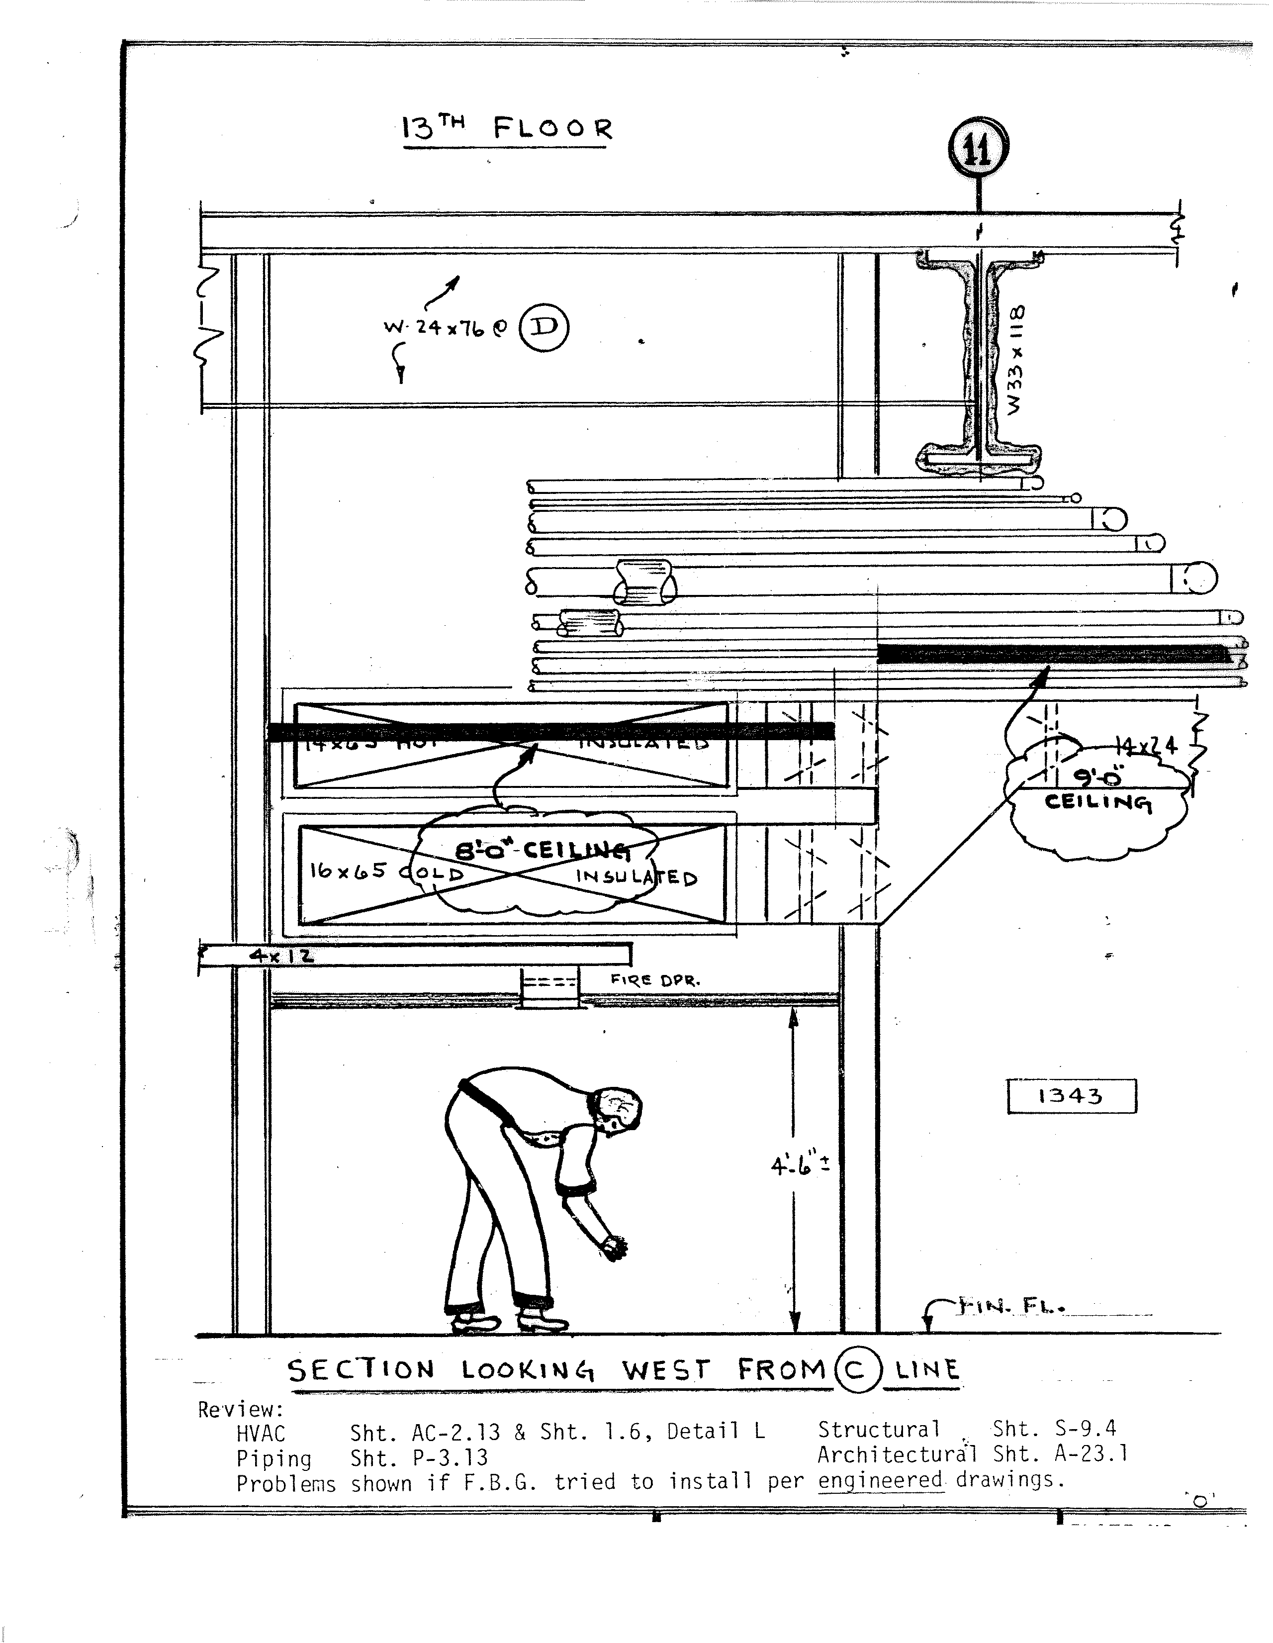
Issue: Failure to Coordinate Plans

Slide 36
Plans Not Coordinated
Contractor gave Notice: Plans not coordinated
Owner Alleges: Contractor’s Duty to coordinate
Contractor redesigns systems: Extra cost and time
Contractor submits claim
Arbitration starts 1 year later, lasts 6 months

Slide 37
Arbitrators’ Ruling:
Contractor had duty to give Notice
Then architect had duty to resolve conflicts
Contractor recovered all extra expense
Real Result: Contractor went out of business

Slide 38
Defective Plans Claim
How would result have been different if DRB panel had existed?
--DRB: timely advise that Architect had duty to coordinate
--Architect: would have redesigned
--Contractor: would have been paid for any extra work
--Contractor would still be in business

Slide 39
Issue: Loss of Productivity
Who is Responsible for losses in Productivity
AACE's RP No. 25R-03:
Estimating Lost Labor Productivity In Construction Claims:
---identifies 25 causes of labor productivity losses

Slide 40
Issue: Loss of Productivity
1. Absenteeism and the missing man syndrome
2. Acceleration (directed or constructive)
3. Adverse or unusually severe weather
4. Availability of skilled labor
5. Changes, ripple impact, cumulative impact of multiple changes and rework
6. Competition for Craft Labor
7. Craft turnover
8. Crowding of labor or stacking of trades

Slide 41
Issue: Loss of Productivity
9. Defective engineering, engineering recycle and/or rework
10. Dilution of supervision
11. Excessive overtime
12. Failure to coordinate trade contractors, subcontractors and/or vendors
13. Fatigue
14. Labor relations and labor management factors
15. Learning Curve
16. Material, tools and equipment shortages
17. Over-manning

Slide 42
Issue: Loss of Productivity
18. Poor morale of craft labor
19. Project management factors
20. Out of sequence work
21. Rework and errors
22. Schedule Compression Impacts on Productivity
23. Site or work area access restrictions
24. Site conditions
25. Untimely approvals or responses

Slide 43
Issue: Loss of Productivity
Who can best correctly and timely determine merits of a dispute alleging “Disruption causing a loss in Productivity?”
A judge or jury
An Arbitrator
A DRB panel
Who would you want?

Slide 44
Issue: Delay or Disruption
Who can best correctly and timely determine merits of a delay dispute?
A judge or jury
An Arbitrator
A DRB panel
Who would you want?

Slide 45
Issue: Delay or Disruption
Evaluation includes
Determination of causes of delay
Determine party responsible
Determine Impact: Analyses of CPM schedule and Cost

Slide 46
Issue: Scope Change
Scope Change or Mere Clarification
Who can best determine merits of allegation

Slide 47
Damages: an Issue in All Disputes
Legal Standard:
Put party back into position it would have been if the default by the other party had not occurred.
Who can best determine?
A judge or jury
An Arbitrator
A DRB panel
Who would you want?

Slide 48
What process do you want to Resolve disputes?

Slide 49
Issue: ADR Recommended Practice
Litigation with judge or jury?
Mediation (assisted negotiation)
Arbitration?
Dispute Resolution Board?

Slide 50
ADR: MY Recommended Practice
Dispute Resolution Board (DRB)
Private
In “Real Time”
By knowledgeable persons
Less costly
More timely
But remember, DRB only gives Recommendations
Then parties must resolve

Slide 51
Dispute Resolution Board (DRB)
Decision by pre-selected knowledgeable persons
Decision is a Non-binding Recommendation
Dispute Resolved in “Real Time”
No need for Discovery –Everyone still available
Private

Slide 53
Avoidance and Prevention

Slide 54
Avoidance and Prevention
Shared Communications
Partnering
Bid Document Escrowing
Clear Contract Language
Assumption of Risk
Document Exchange
Presence of DRB prompts parties to resolve disputes

Slide 55
Avoidance and Prevention
Disputes are avoided or lessened if the contract documents address anticipated risks in clear unambiguous terms.

Slide 56
Clear Unambiguous Contract Terms
1. Notice provisions.
2. Reliance on pre-contract representations.
3. Claim waivers and releases required with pay applications.
4. Fire, weather, natural calamity, and other force majeure issues
5. Delay and disruption costs.
6. Changes.
7. Dispute resolution processes.
8. Insurance obligations.
9. Indemnity provisions.
10. Assessment of consequential damages
11. Guarantees of performance.
12. Coordination of work or equipment furnished by others.

Slide 57
Clear Unambiguous Contract Terms
13. Termination for convenience limitations and conversions.
14. Venue and choice of law provisions.
15. Coordinate of contract drawings.
16. Designation of design responsibility: design or performance specifications
17. Liquidated damages
18. Attorney fees
19. Differing Site Conditions
20. Code compliance
21. Site Access
22. Labor availability

Slide 59
Questions/comments? (Please use microphone)

